Slide 1
Software Engineering and Architecture
UML

Slide 2
Motivation
Communication !!!
  An empirical investigation of software architects showed that about 25% of their time is spend communicating
    Talking to customers, developers, testers, users, …
For design we need a strong language to communicate our design ideas
UML: Unified Modeling Language
  A semi-precise language for overview of architecture and design

Slide 3
UML in SWEA
We use the 20/80 rule
  20% let you get away with 80% of the job
Until we get to distribution we will only use
  Class diagrams Static aspects of design
  Sequence diagrams Dynamic aspects of design

Slide 4
Class Diagram
Static aspect
”The code view”

Slide 5
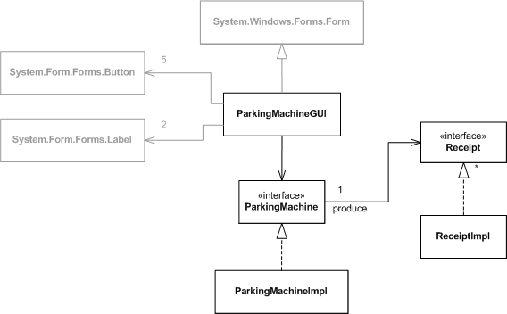
Class Diagram
Road map of design
Take care no to overload with detail...
Class
Navigability
Interface
Realization/impl

Slide 6
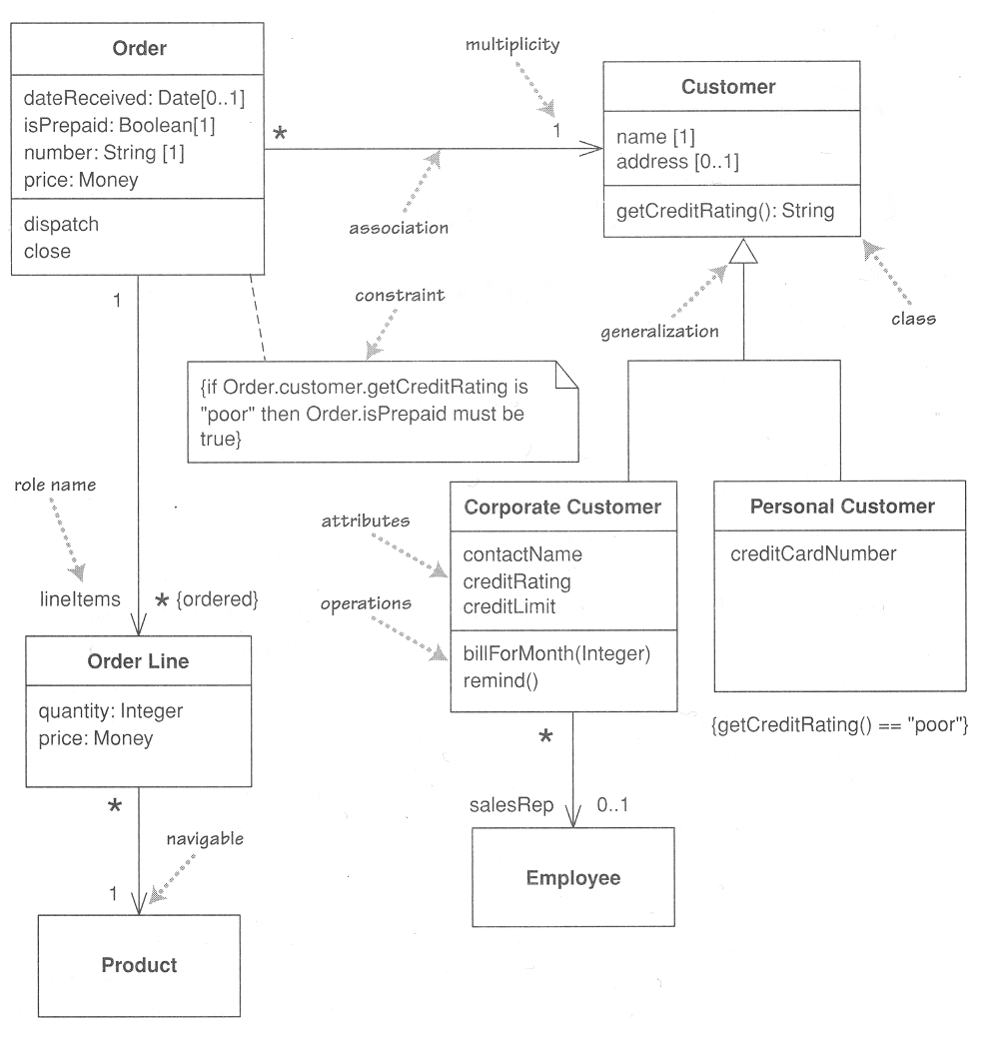
Class diagram
All those details...
Focus: Classes and
their relations.
  classes
    attributes
    methods
  relations
    generalization
    association
  multiplicity
  roles
  navigability
Notes:
Exercise: what does it mean to have a 1-many relation between two classes???
Answer: It constrains the allowable space for object creation of the respective classes.

Slide 7
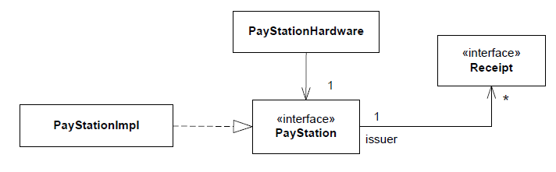
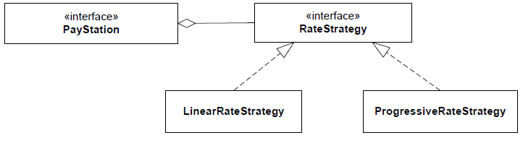
Association/Aggregation
Association
  Casual, temporary
  Independent
Aggregation
  Whole/Part
  Dependent on

Slide 8
Additional notation
Notes allow us to add useful but non-semantic information anywhere.
Drawing
draw()
for each shape {
shape.draw();
}

Slide 9
Architecture Vrs Code
UML should be used to express architecture/design
”You cannot draw that association because an interface cannot contain an object reference to a receipt object.”
Yes I can, I am the architect, god damn it!
  I dictate that all PayStation realizations must have it!

Slide 10
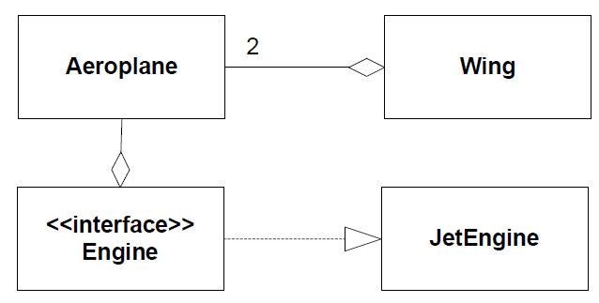
Exam Note
Many of you will have to draw UML on the whiteboard!
Arrows and direction matter! It is a language.
  “I have a yellow banana in my hand.”
  “Hand have yellow I in my banana.”
  I see quite a lot of the last type of ‘sentences’ at exam ☹
Exercise:
  What does this
  aero plane design
  express?
  Why is it nonsense
These are different sentences!

Slide 11
Sequence Diagram
Dynamic aspect
”The execution view”

Slide 12
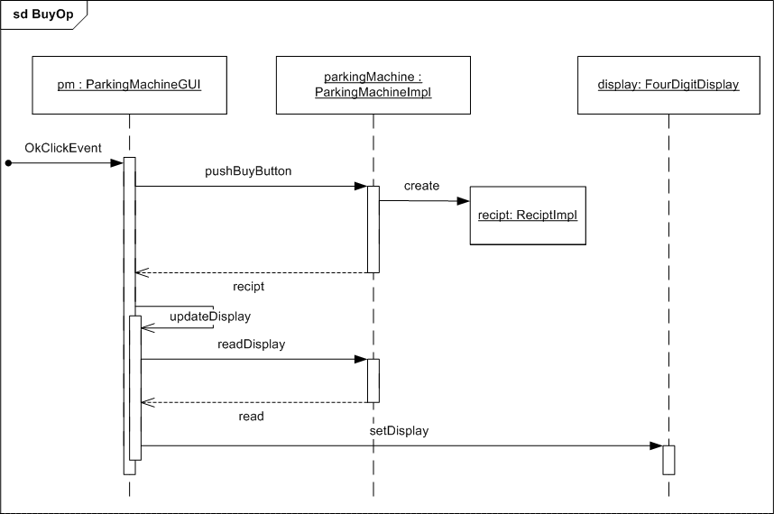
Behavior
Participant (object)
Sequence diagrams
  Describe a single scenario
Example
  Buy ticket sequence
Timeline
creation
message
return
self-call
activation

Slide 13
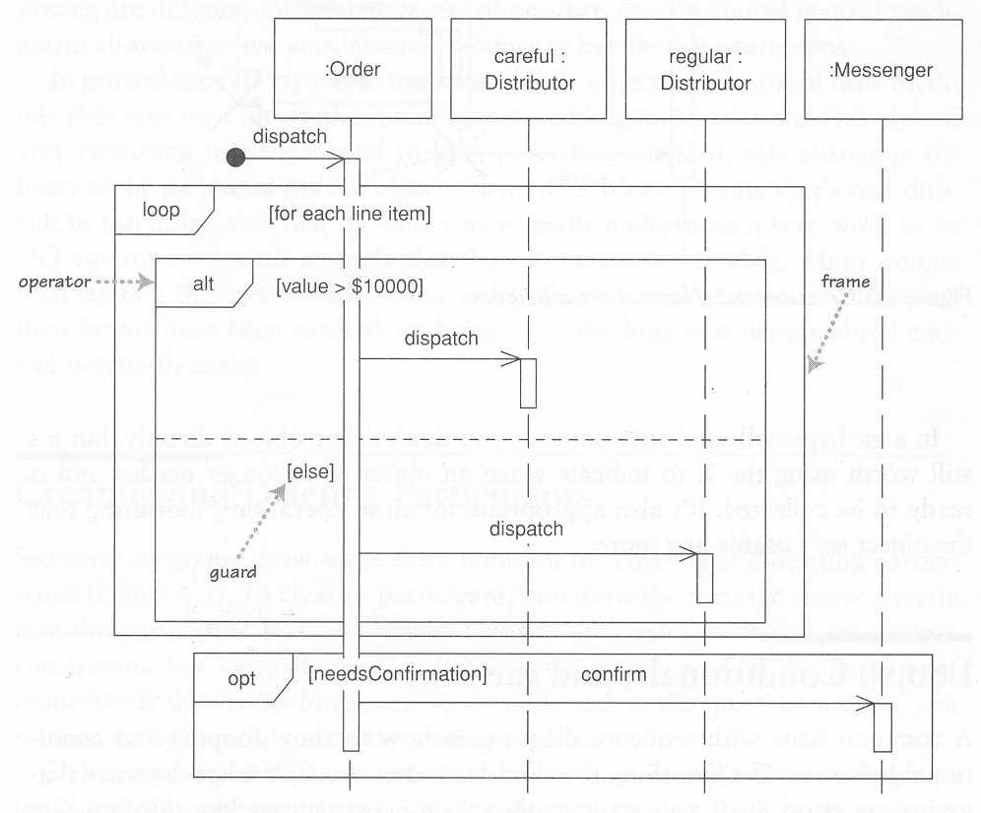
Interaction frames
UML 2.0 may describe loops and conditional statements.
My advice: Do not overuse!!!

Slide 14
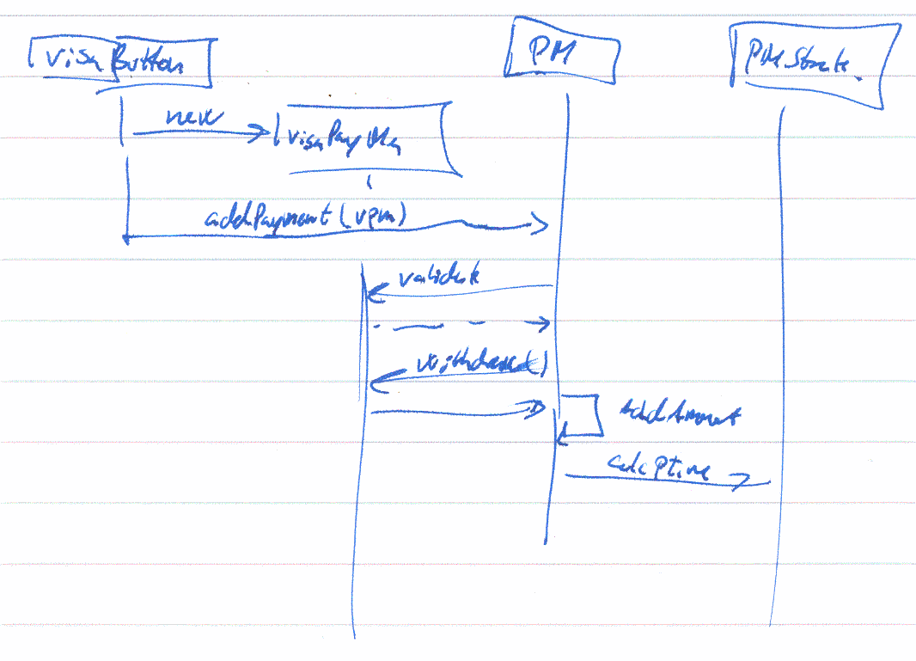
Playing around during design
Dynamics is the most important aspect of computing!
  Nice to play around

Slide 15
Summary
UML A visual language for architecture and design
Class diagram Interfaces and classes / static
Sequence diagram Method calls / dynamic
Train the syntax and semantics
  Will be required in mandatory for communication
  Will be required in oral exam for communication

